Slide 1
Edinburgh Supply Teachers
Thursday, May 30, 2024

Slide 2
164
Total Responses
Date Created: Thursday, April 25, 2024
Complete Responses: 164

Slide 3
Q1: Are you on CEC’s supply list as you are a teacher who has…
Answered: 148 Skipped: 1

Slide 4
Q2: Do you have a protected characteristic under the terms of the Equality Act 2010 ( e.g. Are from BME community; are a disabled member; are pregnant)?
Answered: 149 Skipped: 0

Slide 5
Q3: Are you on the supply list…
Answered: 148 Skipped: 1

Slide 6
Q4: Is CEC the only Council for which you work as a supply teacher?
Answered: 148 Skipped: 1

Slide 7
Q5: How long have you been on CEC’s supply list?
Answered: 148 Skipped: 1

Slide 8
Q6: Do you know what salary point you are on?
Answered: 149 Skipped: 0

Slide 9
Q7: If you are not at the top of the Main grade scale, do you know how to access going up a salary point?
Answered: 114 Skipped: 35

Slide 10
Q8: For which category is your current GTCS Registration?
Answered: 149 Skipped: 0

Slide 11
Q9: If it is for secondary, please select your subject/ main subject
Answered: 46 Skipped: 103

Slide 12
Q10: Thinking about the time from the beginning of term in January 2024 to 27 March 2024, how often were you able to secure supply work?
Answered: 110 Skipped: 39

Slide 13
Q12: In which sector was this work ( or the majority of this work) undertaken?
Answered: 93 Skipped: 56

Slide 14
Q13: Thinking now about the academic year, 2023-24, so far, has the majority of your supply work been...
Answered: 94 Skipped: 55

Slide 15
Q14: Thinking about your supply work since August 2023, have you been satisfied your pay was calculated correctly on each occasion?
Answered: 94 Skipped: 55

Slide 16
Q15: If you thought it wasn’t, was the matter resolved to your satisfaction?
Answered: 50 Skipped: 99

Slide 17
Q16: Have you found CEC’s Teacher Booker system easy to use to obtain work?
Answered: 111 Skipped: 38

Slide 18
Q18: Overall how would you rate Teacher Booker? (One star being poor and 5 stars being excellent.)
Answered: 109 Skipped: 40

Slide 19
Q20: As part of your most common type of supply work, did you normally/ on most occasions (Please select as many as apply.)
Answered: 99 Skipped: 50

Slide 20
Q21: While you have been working on supply this academic year, have you sought out your own Professional Learning?
Answered: 106 Skipped: 43

Slide 21
Q22: If this is not your first year doing supply work, have you had annual PRD meetings?
Answered: 88 Skipped: 61

Slide 22
Q24: If you have been a supply teacher before August 2023, have you had to fulfil the requirements of the Professional Update scheme?
Answered: 85 Skipped: 64

Slide 23
Q25: If you did undertake PU, was it difficult to complete?
Answered: 47 Skipped: 102

Slide 24
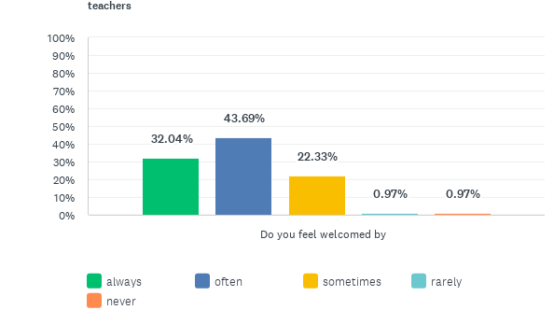
Q27: Thinking about your experience as a supply teacher since August 2023 until now, or before that if you have not had supply work in CEC this session, in all or the vast majority of cases...
Answered: 103 Skipped: 46

Slide 25

Q27: Thinking about your experience as a supply teacher since August 2023 until now, or before that if you have not had supply work in CEC this session, in all or the vast majority of cases...
Answered: 103 Skipped: 46

Slide 26
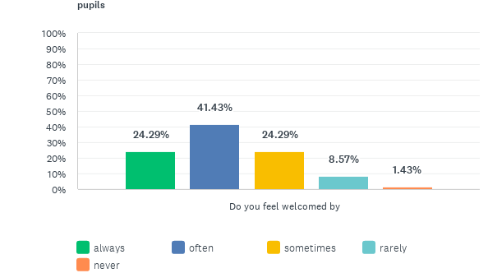
Q27: Thinking about your experience as a supply teacher since August 2023 until now, or before that if you have not had supply work in CEC this session, in all or the vast majority of cases...
Answered: 103 Skipped: 46

Slide 27
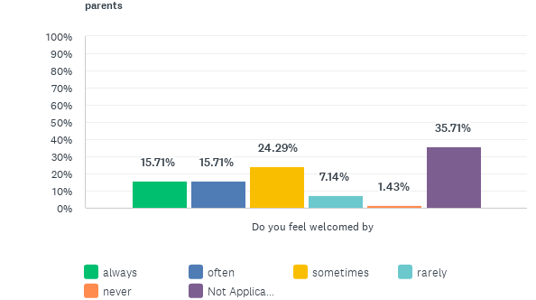
Q27: Thinking about your experience as a supply teacher since August 2023 until now, or before that if you have not had supply work in CEC this session, in all or the vast majority of cases...
Answered: 103 Skipped: 46

Slide 28
Q28: Pupil additional support needs?
Answered: 102 Skipped: 47

Slide 29
Q29: Health and safety issues (e.g. fire procedures)?
Answered: 102 Skipped: 47

Slide 30
Q30: Log-in details for computers?
Answered: 102 Skipped: 47

Slide 31
Q31: The registration process?
Answered: 100 Skipped: 49

Slide 32
Q32: Lesson plans for the day?
Answered: 102 Skipped: 47

Slide 33
Q33: Schemes of work/relevant teaching materials?
Answered: 102 Skipped: 47

Slide 34
Q34: Where you can find resources such as pens, paper and so on?
Answered: 102 Skipped: 47

Slide 35
Q35: Where rooms are/ a map of the school/ a tour of the school?
Answered: 102 Skipped: 47

Slide 36
Q36: The staff signing-in and out process?
Answered: 102 Skipped: 47

Slide 37
Q37: Where to get keys for access to rooms and, if appropriate, to toilets?
Answered: 102 Skipped: 47

Slide 38
Q38: Key school policies, e.g, use of mobile phones, pupil toilet access?
Answered: 102 Skipped: 47

Slide 39
Q39: What you have to do in relation to processing claims for pay?
Answered: 102 Skipped: 47

Slide 40
Q40: How to access the staffroom, food and drink facilities and toilets?
Answered: 101 Skipped: 48

Slide 41
Q41: What to do in case of accidents/ a need for first aid?
Answered: 102 Skipped: 47

Slide 42
Q42: What to do in an emergency/ when in need of assistance?
Answered: 101 Skipped: 48

Slide 43
Q43: Current issues within the school e.g. building work, roof leak?
Answered: 102 Skipped: 47

Slide 44
Q44: A copy of your timetable with breaks and lunchtime indicated and, where appropriate, length of teaching periods?
Answered: 101 Skipped: 48

Slide 45
Q45: Pupil behaviour issues?
Answered: 102 Skipped: 47

Slide 46
Q46: Pupil medical needs?
Answered: 102 Skipped: 47

Slide 47
Q47: How often do you need to bring in or buy your own resources for teaching or to create them if you are returning to the same school the following day?
Answered: 101 Skipped: 48

Slide 48
Q48: Thinking about the academic year to date (or last session if you have not been on supply in CEC this session), have you experienced any verbal or physical abuse from pupils?
Answered: 101 Skipped: 48

Slide 49
Q49: Thinking about the academic year to date (or last session if you have not been on supply in CEC this session), have you experienced verbal abuse from pupils?
Answered: 77 Skipped: 72

Slide 50
Q50: If yes, was appropriate action taken?
Answered: 73 Skipped: 76

Slide 51
Q51: Thinking about the academic year to date (or last session if you have not been on supply in CEC this session), have you experienced physical violence from pupils?
Answered: 79 Skipped: 70

Slide 52
Q52: If yes
Answered: 35 Skipped: 114

Slide 53
Q54: Have you considered applying for, or have applied for Universal Credit during the current academic year?
Answered: 103 Skipped: 46

Slide 54
Q55: Has working as a supply teacher impacted negatively on your health, personal plans or family life?
Answered: 103 Skipped: 46

Slide 55
Q56: Looking ahead to academic year 2024-25 do you...
Answered: 103 Skipped: 46

Slide 56
Q59: If permanent supply posts within CEC could be established ( for example, requiring you to work within a designated cluster of schools each week for a term on a full-time or part-time basis), would such a post be of interest to you?
Answered: 103 Skipped: 46

Slide 57
Q62: Do you wish to leave your contact details?
Answered: 102 Skipped: 47

